Slide 1

World Mental Health Day Colleges Pack
10 October 2025
Created in conjunction with

Slide 2
Mental health doesn’t take a day off

Slide 3
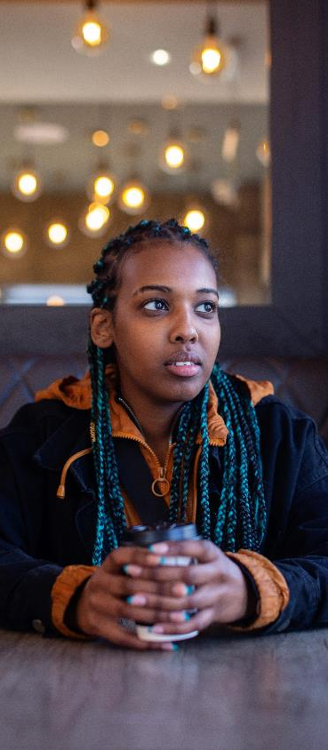

World Mental Health Day 10 October 2025
This pack has been developed especially for colleges, in conjunction with Waltham Forest College. We are grateful for all their help and insights.
Mental health affects us all differently, and it’s an important part of our lives every day, not just one day of the year.
Everyone deserves the right support when they need it, and no one should have to face a mental health problem alone. We hope the topics in this pack will be useful to you and your learners.

Slide 4

Contents
Where to get help (slides 5-7)
How to support a friend with their mental health (slides 9-10)
Exam stress (slide 12)
Looking after your mental health online (slide 14)
Cyberbullying (slide 15)
Self harm and how to cope (slides 17-18)
Suicidal thoughts (slides 20-22)
Posters and social posts for World Mental Health Day (slide 24)

Slide 5
Where to get help 24/7
Some helplines are open 24/7 if you want to talk about…
Anything at all – call Samaritans on 116 123
Abuse - call Childline on 0800 1111
Crime and traumatic events – call Victim Support on 0808 168 9111
Crisis support – text SHOUT to 85258
Domestic abuse (Wales only) – call Live Fear Free on 0808 80 10 800
Drugs and alcohol – call FRANK on 0300 123 6600
Suicidal thoughts – call HOPELINE247 on 0800 068 4141

Slide 6
Support for specific communities
Bayo bayo.uk An online search tool to find mental health and wellbeing support or services, run by and for the Black community.
Being Gay is OK bgiok.org.uk Provides advice and information for LGBTQ+ people under 25 years old.
Mermaids 0808 801 0400 mermaidsuk.org.uk Support for transgender, nonbinary and gender-diverse people up to 18 years old. Runs events, local groups, a youth forum and a webchat.
Muslim Youth Helpline 0808 808 2008 / myh.org.uk Provides faith and culturally sensitive support to young Muslims by phone, webchat and email.

Slide 7
Support for specific issues
Free and impartial money advice
Money Advice Service
T 0800 138 7777
www.moneyadviceservice.org.uk
If you are over 18…
Mind’s Welfare Benefits line
0300 222 5782
Mind’s Legal Line 0300 466 6463
For all of Mind’s helplines https://www.mind.org.uk/information-support/helplines/

Slide 8
How to help a friend with their mental health

Slide 9
Helping friends and family
It can be hard to know if someone's struggling with how they're feeling and their mental health. Here’s some ways you can start a conversation…
“Hey, I'm here for you if you want to talk.”
“We haven't talked in a while. What's been happening?”
“I've noticed you seem tired lately. Is there anything you want to talk about?’’
“I remember you told me that you were upset about ___ last week. How are you feeling about it now?”
“If you ever need to talk to anyone, you know that I'm here for you?”
“I know you're going through some stuff, I'm here for you.”
Notes:
More information on how to support someone with their mental health is available here https://www.mind.org.uk/for-young-people/supporting-others/intro-to-supporting-friends-or-partners/

Slide 10
5 ways to support someone
1. Help them with practical things. You might go to appointments with them or help them with missed college work.
2. Find ways for them to stay in contact with family, friends and other people in their lives.
3. Do things together you enjoy like shared hobbies, walking in nature or watching a film. They might say no but it's important to keep trying to invite them to do things.
4. Check in on them. Sending a text to see how they are or sending them a photo of something they like can let them know you care.
5. Remind them of why they matter. You could talk about how they're important to you or about the good times you've had together.

Slide 11
Exam stress

Slide 12
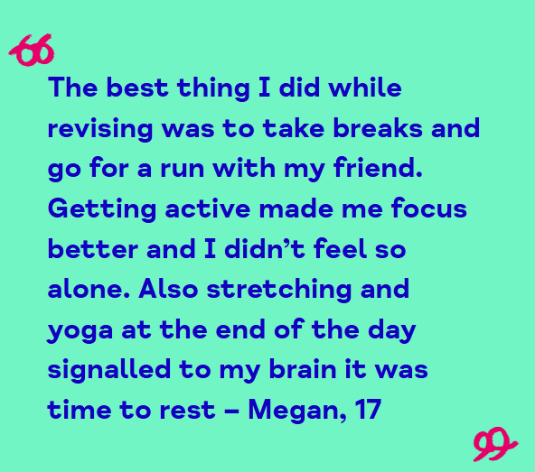
Exam stress
Take care of your wellbeing – your physical health as well as your mental health. Sleep is a good place to start.
Talk to someone you trust. For ideas on how to start the conversation, see our page on opening up to others.
Be realistic about what you can do in a day or a week.
You could also try the Pomodoro technique. This is where you work for 25 minutes and then take a break for 5 minutes. After doing this four times, you then take a longer break.
Notes:
Exam stress can feel like a lot to cope with, but there are things you can do to look after your wellbeing. We have tips and ideas to help you cope at different times. Remember: we are all different, so what works for you might not be the same as what works for someone else. You might also have to try a few different things to see what works best. For more information, take a look here Info on exam stress - for 11-18 year olds | Mind

Slide 13
Online safety

Slide 14
Looking after your mental health online
Think about who will see what you share – never include details that identify you
Protect yourself from excessive online spending - it's very easy to spend money online. When we're not feeling well, we might try and make ourselves feel better by spending money - but this might make us feel worse in the long-run.
Protect yourself from triggering content - if you come across something that upsets you, close the screen or scroll quickly past it.
Protect yourself and others by thinking about the impact of what you share - you might want to consider using a content warning in some cases.
Notes:
When you're online it's important to think about how to keep yourself safe. While there are many benefits to your mental health, there are also challenges. And there are things that could put you at risk or negatively impact your mental health.
Find out more here: https://www.mind.org.uk/information-support/tips-for-everyday-living/looking-after-your-mental-health-online/about-your-mental-health-online/
Safety and privacy | Online mental health support | Mind
These are some tips which may help to keep you safe.

Slide 15
Cyberbullying
If you experience bullying or abuse online, there are things you can do immediately:
Don't respond. It can encourage further unwanted communication.
Restrict the person. Many online services offer options to block, mute, hide, snooze or delete other people.
Keep records of any posts or messages that you've received.
Report it to the site moderators. You can also report harmful content to the national reporting centre Report Harmful Content if this hasn’t worked.
Talk to a trusted friend or family member – or someone at college.
Contact the police if you’re being threatened or abused online and you feel in danger. You can contact them online or call 101. If you are in immediate danger, call 999.
Notes:
It can be horrible to experience bullying or abuse online. And it can have an impact on your mental health. Remember – you don't have to put up with it. Here are some ideas about how to deal with it.

Slide 16
Self-harm

Slide 17
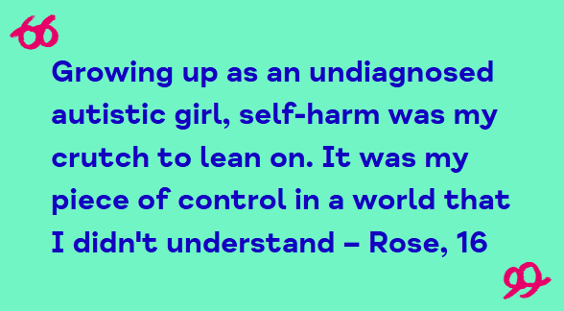
Self-harm
Warning – this topic might cause difficult feelings
We might self-harm for many different reasons. It might be to deal with something difficult in our lives. Or a way to try to cope with overwhelming feelings. Sometimes, we might not know why we hurt ourselves.
Notes:
We all experience difficult feelings at some point in our lives, and cope in different ways.
Some of us might use self-harm to try to cope, or think about doing this.
Self-harm can affect us in lots of different ways. It can feel hard to understand or talk about self-harm, but help is out there for you.

Slide 18
How to cope
A safety plan can help manage distressing or upsetting feelings. You can use it when you have thoughts about hurting yourself.
A safety plan could list:
Warning signs that you might self-harm
Helpful ways to cope
What other people can do to help
Phone numbers of your doctor or crisis team
You can keep it somewhere that's easy to access, like in your bag, or as a screenshot or file on your phone. Or you could stick it on your wall in a place where you can easily see it.
Download your safety plan
Notes:
My safety plan
Further information can be accessed here: https://www.mind.org.uk/for-young-people/feelings-and-experiences/understanding-self-harm/ and https://www.mind.org.uk/for-young-people/feelings-and-experiences/tips-for-coping-with-self-harm/

Slide 19
Suicidal thoughts

Slide 20
Suicidal thoughts
Warning – this topic might cause difficult feelings
Many of us think about suicide at some point in their lives, and it can happen to any of us. Letting someone know how you're feeling can be an important first step to getting help.
But it can feel hard to open up to people. You might feel:
Unable to tell someone
Unsure of who to tell
Concerned that they won't understand
Fearful of being judged
Worried you'll upset them
Notes:
If you would like more advice on how to open up, there’s some more information here Tips for opening up to someone - for 11-18 year olds | Mind

Slide 21
Tips on how to cope
Focus on
getting through
the next
5 minutes
Tell someone how you’re feeling
Calm your
body and mind
Challenge your thoughts
Make a safety plan
Learn ways to manage difficult feelings
Practice being kind to yourself
Connect with other people
Look after your physical health
Seek support for suicidal thoughts
Notes:
This webpage has further information on all of these ideas – not every tip will help everyone but hopefully there will be something that will work for you Tips for coping with suicidal thoughts | self-care | Mind

Slide 22
How to get help
If you feel like you might attempt suicide, or may have seriously harmed yourself, you need urgent medical help.
Call 999 for an ambulance
Go straight to A&E, if you can
Mental health emergencies are serious. You're not wasting anyone's time.
Whatever you're going through, there are people you can talk to any time. You can:
call Samaritans on 116 123 (UK-wide)
text SHOUT to 85258 (UK-wide)
These services are for anyone who's struggling.
They should treat you with care and respect
They're free, they're anonymous, and they're always open.

Slide 23
Posters and social posts for World Mental Health Day

Slide 24

Share the campaign
Download posters and social posts to promote World Mental Health Day at your college.
https://www.mind.org.uk/get-involved/world-mental-health-day/#assets

Slide 25
No mind left behind mind.org.uk

