Slide 1
Mental health
If this speaks to you, speak to Mind
Notes:
In this lesson we are going to talk about mental health. These resources have been provided by Mind. For those of you who haven’t heard of Mind, it’s a mental health charity. They provide advice and support to anyone experiencing a mental health problem, and campaign to improve services and awareness. You may have seen a Mind charity shop on the high street or a Local Mind office that provides services and support to the local community.
In this lesson we will hear people share their experience of mental health problems, please be aware you may find their experiences emotional and they could trigger your own feelings. If you would like to talk about what you’ve heard in this lesson and/or your feelings please talk to [school wellbeing support] or you can visit Mind.org.uk for information and support.

Slide 2
Put your hand up if:
You have physical health
You have ever broken a bone?
You have ever cut your finger?
You have ever had a head ache?
You have ever had a toothache?
You have ever had a tummy ache?
You have ever fallen and been in pain?
Notes:
EXERCISE: Let’s start by thinking about our physical health – things to do with our body.
I will say a statement, and if this is something you have felt before, you put your hand up :
Put your hands up…
EXERCISE: Ask, what can make us feel better? – can anyone think of and share some ways we look after our physical health? For example, when we have a headache or broken bone.

Slide 3
Now I want you to think if:
You have mental health?
You have felt happy in the last week?
You have felt sad in the last week?
You have ever felt excited?
You have ever felt scared?
You have ever felt worried?
Notes:
EXERCISE: Now let’s start thinking about our mental health.
I’m not going to ask you to put your hand up for this exercise, as not everyone will feel comfortable sharing their feelings and mental health experiences. So I am just going to read out the statement and give you the opportunity to think about it.
You have mental health?
You have felt happy in the last week?
You have felt sad in the last week?
You have ever felt excited? Explainer: Excitement could be what you felt when you were going on holiday or when you were little and waiting to meet Father Christmas.
You have ever felt scared? Explainer: This might be what you feel when you’re somewhere heigh up, you see a spider in the room, or you’re going to a new place. Different people are scared of different things.
You have ever felt worried? Explainer: This could be what you feel before your first day of school, or before a competition like a football match.
All of these feelings make up our mental health. It’s important to remember that we all have mental health the same way we all have physical health. Sometimes our mental health is good, other times, its bad. Like physical health, there are ways we can look after our mental health which we will talk about later in today’s session.

Slide 4
Mental health is about how we think, feel and act. Just like physical health, everybody has it.

Slide 5
What is mental health?
Our mental health is on a spectrum, and can range from good to poor. Good mental health can help you to think positively, feel confident and act calmly.
Poor mental health, is when everyday things become difficult to cope with.
Notes:
Mental health can effect your body. If you’re feeling anxious you may feel nauseous (sick), dizzy or have a headache.

Slide 6
3 in 5 young people have either experienced a mental health problem themselves, or are close to someone who has.

Slide 7
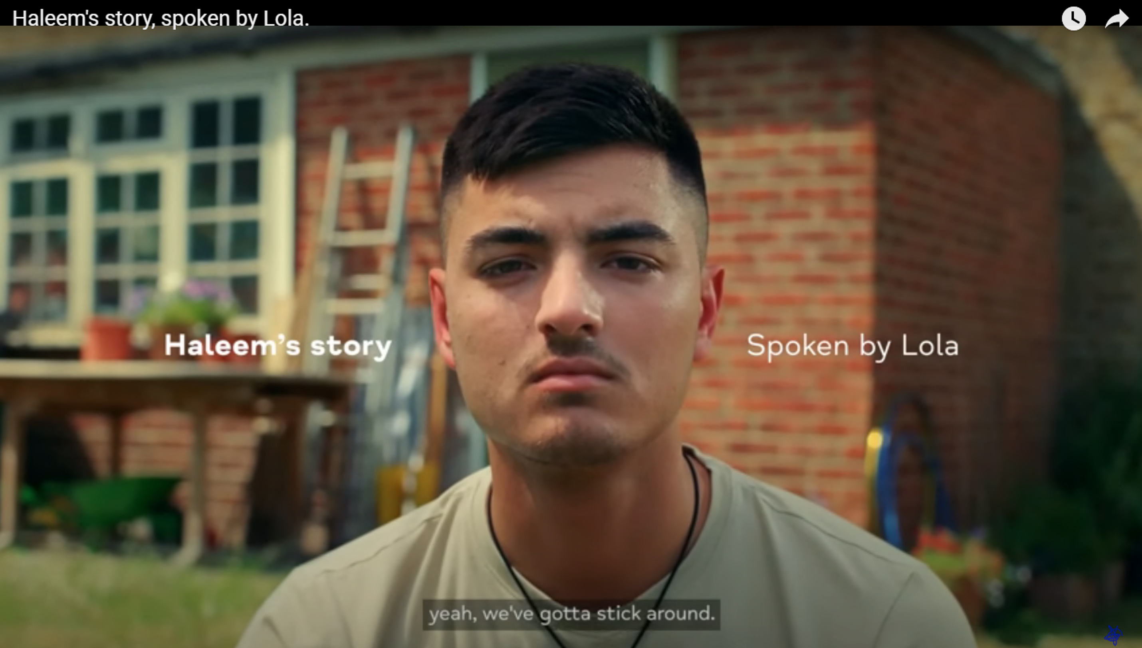
Haleem’s story
Notes:
Talking about mental health helps to raise awareness about mental health problems, and brings conversations into the everyday. Mental health charity, Mind, created a series of films which share people’s experience of mental health. They paired Haleem with spoken word artist, Lola, to help bring his experience of mental health to life through poetry.
Watch this 1 minute video (https://www.youtube.com/watch?v=kifdSXnHse0).
EXERCISE
Now watch this video again think about:
How does Haleem feel about his mental health?
What words does he use to describe how he feels?
Did other people’s views of mental health impact him?
Once the film has played I will leave the words of Haleem’s poem on screen so that you can reflect on these questions.
OPTIONAL: Worksheet provided students can think about questions individually or write thoughts down on the worksheet provided which is intended to be a takeaway resources providing signposting information.

Slide 8
Haleem’s story
I was a quiet child with a loud mind.
Aged 5 Father said big boys don't cry.
I guess that's why I walked blind,
sunken-eyed.
Each step takes time, Mother said.
Strength comes with patience,
and patience comes with intent.
I didn’t have much of either,
just enough to roll out of bed.
I read this book one time; the words were like flesh.
It taught me something that I'll never forget –
that dandelions are like 80% of people
that can bloom in any environment.
You see, me, I’m more like an orchid instead,
I need a little more sun sometimes
and wind can send me off edge.
But one thing I've learnt is the mind is made of glass,
half full or half empty depends on the circumstance.
But even when I'm quiet, and even when it’s loud,
me, myself and I, yeah, we've gotta stick around.
Notes:
Here are the words of Haleem’s story to help you with this exercise.
EXERCISE
How does Haleem feel about his mental health?
What words does he use to describe how he feels?
Did other people’s views of mental health impact him?
OPTIONAL: Worksheet provided students can think about questions individually, in a group or write thoughts down on the worksheet provided which is intended to be a takeaway resources providing signposting information.

Slide 9
What is a mental health problem?
A mental health problem is when the way you're thinking, feeling or acting becomes difficult for you to cope with.
We can all feel sad, worried, angry or fed up at times – like nerves before an exam or feeling down when a friend moves away. But if these feelings last a long time, it might be a sign that you need more help. For example, if the way you feel:
impacts you most days
stops you from doing the things you enjoy
makes you feel like you can't cope anymore.
Mental health problems are very common.

Slide 10
Whatever you’re experiencing, it’s important to know that you’re not alone and you deserve support.

Slide 11
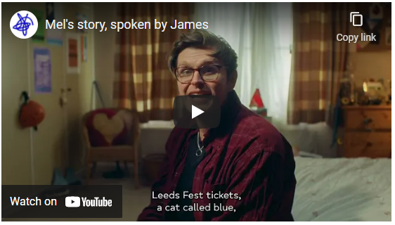
Mel’s story
Notes:
Mind paired Mel with James from Leads' rock band Yard Act, to bring her experience of mental health to life through poetry.
Watch this 1 minute video (https://www.youtube.com/watch?v=U7no0JDUFwI)
EXERCISE
Now watch this video again and discuss with your neighbour, partner, group or table:
Do you think her friends and family would have known that she was experiencing a mental health problem?
How did Mel feel?
OPTIONAL: Volunteers feedback and share their thoughts with the class.
Points to highlight: Mel smiles and looks like she has a great life, this hids the mental health problems that she is experiencing and means that the people closest to her don’t know about her difficulties.

Slide 12
Mel’s story
Don’t assume that the life someone’s living
is a given, due to the smile on their face.
You don’t know what goes on in my head,
when I’m alone in this place.
When mum and dad go out
and all other distractions are exhausted,
that’s when the thoughts in my head roar,
until I can’t ignore those thoughts no more.
So I disappear up here until my throat gets so sore.
These patterns are collateral for all that you stole,
dragging me in and hauling me out of the hole.
It’s a cycle that gives me a sense of control.
And I’ve a good life too,
Leeds Fest tickets, a cat called Blue.
A job helping others, a family that loves us,
So why?
You never really know what’s going on
in someone else’s head, do you?
And if you don’t understand, then don’t “assume”.
Suddenly, the whole world knows what’s best for my health!
But right now, in this moment,
I just need to feel some control for myself.
Notes:
Here are the words of Mel’s story to help you with this exercise.
EXERCISE
Do you think her friends and family would have known that she was experiencing a mental health problem?
How did Mel feel?
OPTIONAL: Volunteers feedback and share their thoughts with the class.
Points to highlight: Mel smiles and looks like she has a great life, this hides the mental health problems that she is experiencing and means that the people closest to her don’t know about her difficulties.

Slide 13
Helping my mental health
Talking being open with people I trust about how I’m feeling.
Exercising looking after my body, playing sport, eating healthy.
Calming trying meditation, good sleep habits like turning phone off early.
Learning a new skill, a great way to gain confidence.
Relating spending time with the people I care about.
Contributing helping others or contributing to causes I believe in.
Creating expressing myself creatively e.g. music, art, drama, writing.
Congratulating being kind to myself or listing the qualities I value in myself.

Slide 14
Wellbeing first aid kit
Using the suggestions on the previous slide, create your own mental health first aid kit. Include the types of things that you could do when you’re finding things hard.
Here’s an example:
Chatting to my best friend about how I’m feeling
Drawing while listening to my favourite music
Having a long bath
Notes:
EXERCISE: Your wellbeing first aid kit will be unique to you. You can take inspiration from the previous slide, and include the things that you know work for you when you’re not feeling yourself.
Share your wellbeing first aid kit with the person sitting next to you. Discuss why you have selected those activities and how they make you feel.

Slide 15
Support
There are lots of ways you can find support – but you may need to try a few options to work out what's best for you.
**SIGNPOST TO YOUR SCHOOLS WELLBEING SUPPORT**
Visit mind.org.uk for information, signposting and support
www.mind.org.uk/information-support/for-children-and-young-people/finding-support/
Remember: you're not alone and you deserve support.

