Slide 1

Building resilience, promoting wellbeing

Slide 2

Mental health
We all have mental health.
Mental health relates to how we think, feel, behave and interact with other people.

Slide 3
Just as we can develop problems with our physical health, mental health problems will be experienced by many of us over the course of our lives.
One in four people will experience a mental health problem each year
Notes:
Just as we can develop problems with our physical health, mental health problems will be experienced by many of us over the course of our lives.
Mental health problems range from the worries we all experience as a part of our everyday life, to serious long term conditions that can be difficult to manage
One in four people will experience a mental health problem each year

Slide 4
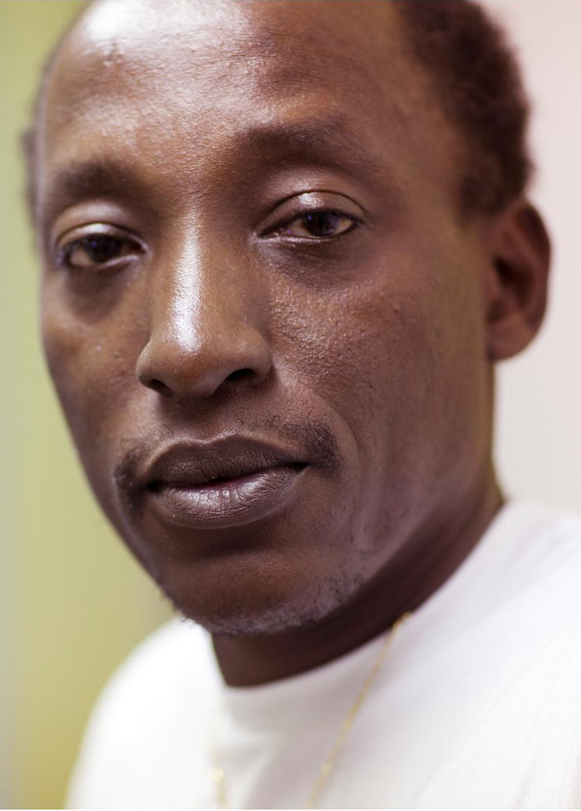
Anxiety and depression are the most common problems, with about 1 in 10 people affected at any given time.
1-2 people in every 100 will experience a serious mental health problem such as bipolar disorder, psychosis or schizophrenia in their life.
Notes:
Anxiety and depression are the most common problems, with about 1 in 10 people affected at any given time.
1-2 people in every 100 will experience a serious mental illness such as bipolar disorder, psychosis or schizophrenia.
People affected may hear voices, see things no one else sees, hold unusual or irrational beliefs, feel unrealistically powerful or feel worthless, with a loss of interest in daily life

Slide 5
Not all mental health problems are preventable. But there are some things we can do to look after our mental health, for example, promoting mental wellbeing and building resilience

Slide 6

Wellbeing
This presentation focuses on mental rather than physical wellbeing
How would you define wellbeing?
Notes:
Discussion point: how would you define wellbeing?
- Try to gather first thoughts on the key concepts, thoughts and feelings that the group associates with wellbeing

Slide 7
The World Health Organisation defines wellbeing as:
  ‘a state of mind in which an individual is able to realise his or her own abilities, cope with the normal stresses of life, can work productively and fruitfully, and is able to make a contribution to his or her community.’
Notes:
- Is this definition similar to the ideas the group came up with?

Slide 8

Wellbeing is made up of two key elements:
Feeling good
Functioning well
What kinds of things contribute to your own sense of mental wellbeing?
Notes:
It can be helpful to understand wellbeing as being made up of two key elements:
1. Feeling good
- Feeling good means experiencing positive emotions like happiness, contentment and enjoyment. It also includes feelings of things like curiosity, engagement and safety.
2. Functioning well
- Functioning well is about how a person is able to function in the world. This includes having positive relationships and social connections, as well as feeling in control of your life and having a sense of purpose
Discussion point: What kinds of things contribute to your own sense of mental wellbeing?
Think about the:
Activities you do
People you see
Things you think about
That help you feel good and function well.
What about your life circumstances - like your housing, finances, age, having a family? Do these contribute positively or negatively to your wellbeing?

Slide 9

Resilience
Resilience is the ability to cope with life’s challenges and to adapt to adversity.
Your levels of resilience can change over the course of your life.
Notes:
We are talking about mental resilience: the ability to cope with life’s challenges and to recover from or adapt to adversity.
Your levels of resilience can change over the course of your life
We aren’t born with fixed levels of/fixed capacity for resilience
It can be learned and improved.
Things that improve our resilience include learning psychological coping skills, doing things that promote our wellbeing, and building social connections.
Resilience can also be eroded or worn down by difficult circumstances e.g. illness, debt, poor housing

Slide 10
Why are wellbeing and resilience important?
Resilience is important because it can help to protect against the development of some mental health problems. Resilience helps us to maintain our wellbeing in difficult circumstances.
What type of things make you feel more or less resilient and able to cope?
Notes:
Why are wellbeing and resilience important?
Resilience is important because it can help to protect against the development of some mental health problems.
People with high levels of resilience are more likely to cope with difficult experiences whilst maintaining high levels of wellbeing
Good levels of resilience help people to recover more quickly if they do experience mental health problems
Discussion point: What type of things make you feel more/less resilient and able to cope?

Slide 11
High levels of wellbeing and resilience in a community don’t just lead to fewer mental health problems…
Good levels of wellbeing are associated with:
  Improved learning and academic achievement
  Reduced absence from work due to sickness
  Reductions in risk-taking behaviours like smoking
  Improved physical health
  Reduced mortality
  Increased community involvement

Slide 12
People at higher risk of low wellbeing
Some people in our community face significant challenges and may need more support than others to improve their wellbeing, for example people who are:
    Socially isolated
    From Black or minority ethnic groups
    On low incomes or unemployed
    Living with a long term health condition
How could you support these groups in your community?
Notes:
Discussion point: How could you support these groups in your community?

Slide 13

Men from households with the lowest 20% of incomes are almost 3 times more likely to have a common mental disorder than those with the top 20%
Black and minority ethnic people are nearly 3 times more likely to attempt suicide
People with less than three close relatives or friends are more likely to experience mental health problems
Rates of depression are double in those with long term health conditions than in the rest of the population
22% of gay and bisexual men are currently experiencing moderate to severe levels of depression

Slide 14
Improving wellbeing
There are a whole range of ways that we can improve our wellbeing and resilience.
The New Economics Foundation has set out five things that we can all do to improve our wellbeing….
Notes:
The New Economics Foundation - Five Ways to Wellbeing www.neweconomics.org/projects/entry/five-ways-to-well-being

Slide 15

Connect…
With the people around you. With family, friends, colleagues and neighbours. At home, work, school or in your local community. Think of these as the cornerstones of your life and invest time in developing them.
Building these connections will support and enrich you every day.

Slide 16

Be active…
Go for a walk or run. Step outside. Cycle. Play a game. Garden. Dance. Exercising makes you feel good. Most importantly, discover a physical activity you enjoy and that suits your level of mobility and fitness.

Slide 17

Take notice…
Be curious. Catch sight of the beautiful. Remark on the unusual. Notice the changing seasons. Savour the moment, whether you are walking to work, eating lunch or talking to friends. Be aware of the world around you and what you are feeling. Reflecting on your experiences will help you appreciate what matters to you.

Slide 18

Give…
Do something nice for a friend, or a stranger. Thank someone. Smile. Volunteer your time. Join a community group. Look out, as well as in. Seeing yourself, and your happiness, linked to the wider community can be incredibly rewarding and creates connections with the people around you.

Slide 19

Keep learning…
Try something new. Rediscover an old interest. Sign up for that course. Take on a different responsibility at work. Fix a bike. Learn to play an instrument or how to cook your favourite food. Set a challenge you will enjoy achieving. Learning new things will make you more confident as well as being fun.

Slide 20
What can you do?
These are not just things that people should do by themselves. Community groups, services, resources and facilities also play a role in helping people to understand the things they can do for their wellbeing, and supporting people to do them.
What services/activities do you provide that promote each of the five ways to wellbeing?
Notes:
Discussion point: What services/activities do you provide that promote each of the five ways to wellbeing?
- Can you list the activities which promote one or more of the five ways to wellbeing?

Slide 21

It’s likely that your organisation is already supporting the wellbeing of the people you work with, even if you are not aware of it.
But if you would like to do more, here are some ideas of the kind of things you could do to improve wellbeing:

Slide 22
1. Promote the five ways to wellbeing
Think about ways you could make the five ways to wellbeing a central part of the services, activities or support you provide.
  Could you organise some physical activities, like a sports team or walking club, helping people to be active?
  Could you organise creative activities that help people take notice and learn, perhaps art or cooking classes, or run a book group?
  Could you facilitate opportunities for people to give their time and volunteer in the community
Notes:
Think about ways you could make the five ways to wellbeing a central part of the services, activities or support you provide.
Can you make the people that you come into contact with more aware of the things they can do to improve their wellbeing.
Could you adapt any of your existing activities to better support people’s wellbeing?
Are there any new services/activities that you could easily provide that would promote any of the five ways?

Slide 23
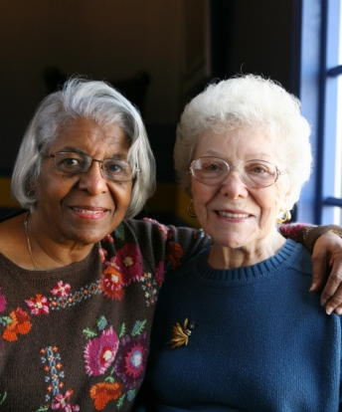
2. Improve opportunities for social connection
Can you do more to bring people together in the work that you so, helping them to build more social connections?
Could you provide a befriending service for the most isolated people in your community?
Could you facilitate peer support groups for people with similar life experiences to come together?
Notes:
Can you do more to bring people together in the work that you so, helping them to build more social connections?
Some of the most isolated in our community may find it difficult to attend community groups or activities.
Could you provide a befriending service for the most isolated?
Providing opportunities for people with similar experiences to come together is a great way to help people deal with difficult circumstances and support their emotional resilience, whether they are unemployed, bereaved, or coping with a long term physical or mental health condition.
Could you facilitate peer support groups for these people?

Slide 24

3. Raise awareness of mental health, wellbeing and resilience
Lots of people don’t feel confident talking about mental health and wellbeing or know enough about what they can do to help.
Raising awareness about mental health can be an important step in making every contact we have with someone in the local community count for wellbeing.
Notes:
Every time we come into contact with someone in the local community we have an opportunity to support them to improve their wellbeing and build resilience, as well as to spot the early signs of mental health problems. Unfortunately, lots of people don’t feel confident talking about mental health and wellbeing or know enough about what they can do to help. We need to make every contact count for wellbeing.
You can use this presentation and its accompanying booklet to prompt discussion around mental health, wellbeing and resilience within your organisation and with those you work with
If you would more in depth training around mental health there are organisations which provide full mental health awareness training, including Mind and the Mental Health Foundation.

Slide 25
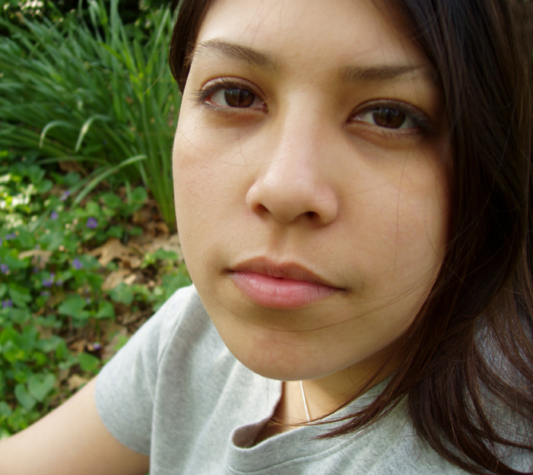
4. Make sure your services are accessible and welcoming
Ensure that your services are appropriate to people of all ages, sexual orientations, disabilities, gender, and race
Notes:
Make sure your services are accessible and welcoming
Ensure that your services are appropriate to people of all ages, sexual orientations, disabilities, gender, and race.
For example, this might include checking whether you could make some of your activities suitable for people who lack mobility, or for people whose first language isn’t English. Not being able to access a local service can in itself affect people’s wellbeing.
Actively reach out to people who may be at increased risk of poor mental health, as described in section five. For example, you may want to specifically promote your services to people with long term physical health conditions or who are unemployed.
There is a lot of stigma around mental health and some people might not feel comfortable attending a group or activity that talks about it. Some groups have found it helpful not to reference mental health when describing their service and instead focus on wellbeing.
Some people find that a lack of confidence or low self-esteem makes it difficult to access services. If you have the resources available, a successful way to help people to overcome this is to run a ‘buddying’ system, providing buddies who can accompany people the first time they come to your group or service.

Slide 26
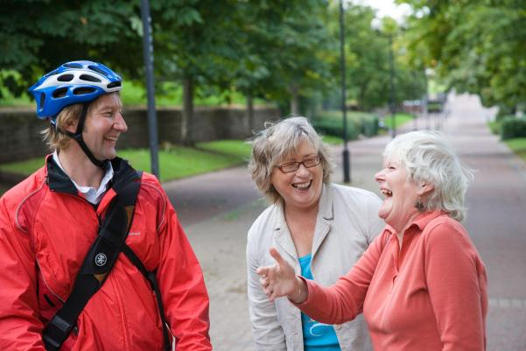
5. Think about the impact your services have on the wellbeing of your community
Could you measure the impact your group has on community wellbeing, using a tool like the New Economics Foundations handbook, ‘measuring wellbeing’?
Notes:
Have people said to you that your service/organisation has had an impact on their wellbeing or happiness? Can you think of examples?
Could you measure the impact your group has on community wellbeing, using a tool like the New Economics Foundations handbook, ‘measuring wellbeing’? (http://www.neweconomics.org/publications/entry/measuring-well-being)
Measuring your impact on community wellbeing can help you:
assess how well your organisation promotes wellbeing and what activities are the most effective
demonstrate the importance of your organisation in the community
support funding applications

Slide 27

6. Connect with other community organisations
Consider ways you could work together with other organisations in the community to improve wellbeing.
Notes:
Could you refer people to other organisations that provide activities that you do not?
Could other organisations direct people to you?
Can you work together to demonstrate the important work you are carrying out in your community?
Can you share examples of good practice, learning you have found useful, and challenges you have faced?

Slide 28

7. Provide information about other services in your area
Think about pulling together a list of other groups and services in your area that you think might be helpful in supporting the wellbeing of the people you work with.
Notes:
Think about pulling together a list of other groups and services in your area that you think might be helpful in supporting the wellbeing of the people you work with.
This can then be used to signpost people to other groups or activities which you think they might find helpful
If your local council provides an information tool or database of activities in the local area that can help to build wellbeing, help to promote this to make sure that the people you work with know where to look.
You could also signpost people to other sources of information or wellbeing support, such as Mind’s guide to improving mental wellbeing or the Mental Health Foundation’s wellbeing podcasts.

Slide 29
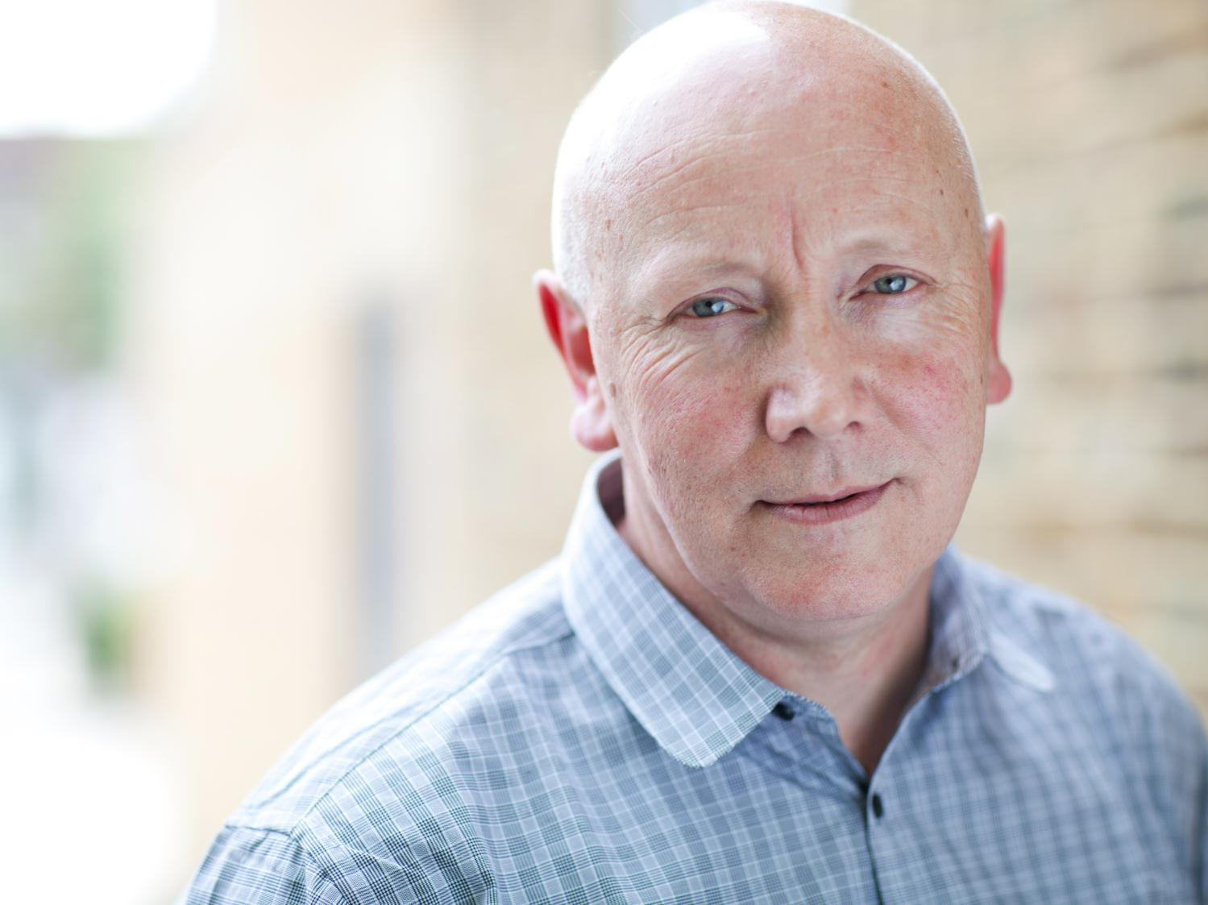
Recognising mental health problems
You may come across people who you think might be experiencing more than just low wellbeing, but may be developing a mental health problem.
The first signs of mental health problems will differ from person to person and are not always easy to spot.
Notes:
In many cases of moderate depression or anxiety – the most common mental health problems – the person becoming distressed may not display symptoms, or may seek to hide them because they worry about what others will say or think about them.

Slide 30
Some common early signs of a mental health problem that you may notice in someone include:
Increasingly anxious
Poor motivation
Indifferent
Being on edge
Dramatic change of personality
Irrational
Hearing and seeing things that others don’t
Self-absorbed
Highly emotional
Unresponsive
Restlessness
Poor personal presentation
Becoming socially isolated
Lack of energy
Problems with sleep
Hyperactivity
Lack of interest in activities that were previously enjoyed
Making statements of self-worthlessness
Distracted
Poor concentration
Extreme mood swings

Slide 31
Helping people get the right support
If you think someone is experiencing a mental health problem and needs help, there are a range of people and organisations that offer advice, support and treatment:
GPs can be the first point of contact for many people – they can offer treatment and advice and can make referrals for more support.
If someone is experiencing severe mental distress they can make an emergency appointment with their GP, or go to the local A&E department. If you are worried that someone is at immediate risk of harming themselves or others you should call 999.

Slide 32







Helplines and websites
There are lots of national telephone helplines and websites that can be contacted for support, with many available 24/7. The booklet that accompanies this presentation contains the contact details for many of these.

Slide 33

How to change things in your area
If you feel strongly that more needs to be done to support the wellbeing of people in your community there are local decision-makers and organisations that you can contact:
  Your local MP
  Your local councillor
  Healthwatch
Notes:
If you feel strongly that more needs to be done to support the wellbeing of people in your community - whether it is making access to mental health services easier, giving more support to community organisations that have an impact on wellbeing, or investing more in local wellbeing services or facilities – there are local decision-makers and organisations that you can contact.
You could try writing to your local MP or local Councillor - they are your elected representatives so it’s your right to tell them what matters to you and ask them to speak up on your behalf. You can find out who your MP and Councillors are and how to contact them at www.writetothem.com or by calling your local council.
Healthwatch is the independent champion for people who use health and social care services in England. Your local Healthwatch can help to raise your concerns with the people who make the decisions. You can find your local Healthwatch online at http://www.healthwatch.co.uk/find-local-heathwatch, or by calling them on 03000 683 000.

Slide 34


For more information, the accompanying booklet and full report please see www.mind.org.uk/publicmentalhealth
We’re Mind, the mental health charity.
We believe no one should have to face a mental health problem alone. We’re here for you. Today. Now. Whether you’re stressed, depressed or in crisis. We’ll listen, give support and advice, and fight your corner.
Registered Charity No. 219830 Registered No. 424348 England
The Mental Health Foundation is a UK-wide charity that carries out research, campaigns for better mental health services, and works to raise awareness of all mental health issues to help us all lead mentally healthier lives.
Registered Charity Nos: (England & Wales) 801130: (Scotland) SC 039714.

Slide 35




This presentation is one of a series of resources produced on behalf of the Mental Health Strategic Partnership with funding from the Department of Health. The Mental Health Strategic Partnership comprises:

